Slide 1
Linear Modeling
By Houbin Fang

Slide 2
Finding Linear Models
Drive at 60 mph
Already drove 50 miles
The distance y, time t
The equation?

Slide 3
Point-Slope Application
Power bill: $0.15 per kwh
Base fee of $31.00 per month.
Total bill y, use x kwh
The equation?

Slide 4
Regression Lines
a linear function can be used to approximate collected data.
use a linear function that is a very close fit to data: Regression line.

Slide 5
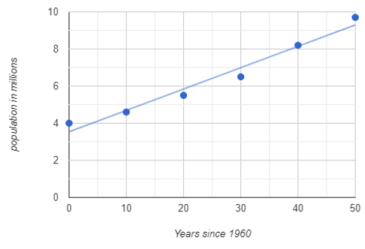
Regression Lines (two points)
Georgia - Historical Population Data
Years since 1960 | Population
50 | 9.7 m
40 | 8.2 m
30 | 6.5 m
20 | 5.5 m
10 | 4.6 m
0 | 4.0 m

Slide 6
Regression Lines (the least-squares line)
Georgia - Historical Population Data
Years since 1960 | Population
50 | 9.7 m
40 | 8.2 m
30 | 6.5 m
20 | 5.5 m
10 | 4.6 m
0 | 4.0 m

