Slide 1
Properties of Linear Functions
By Houbin Fang

Slide 2
Linear Functions
A linear function: f(x) = mx + b, where m is the coefficient of x and b is a constant.
Examples

Slide 3
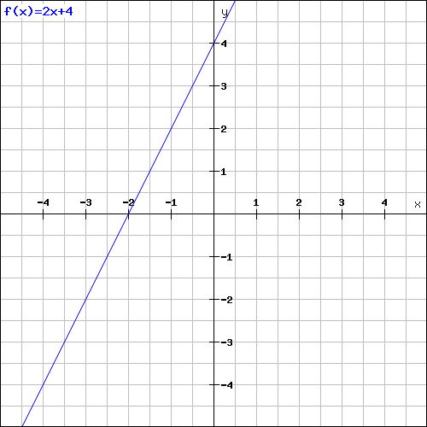
Linear Functions: f(x) = 2x + 4
Ordered Pairs
x-intercept of the graph
y-intercept of the graph
vertical and horizontal axes
x | y

Slide 4
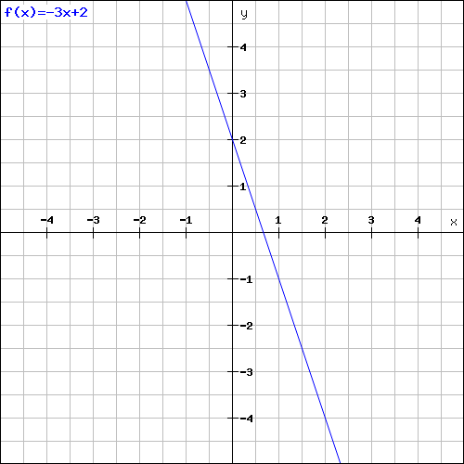
x- and y-intercepts of a Graph
x | y
g(x) = -3x + 2.

Slide 5
Slope
f(x) = mx + b, m, the coefficient.
Find the slope of the following linear functions:
y = -x + 3 f(x) = 2x + 5
y = $\frac{1}{2}x+2$ g(x) = 1 – 4x

Slide 6

Finding Slope?
m = $\frac{change in y}{change in x}= \frac{y_{2}−y_{1}}{x_{2}−x_{1}}$
(-3, 3) and (1, 1)
(-1, 3) and (4, 3)

Slide 7
Notes about Slope
Positive slope increases from left to right.
Negative slope decreases from left to right.

Slide 8
Two-Point Form
Draw the line that passes through (2, 4) and (-2, 2)

Slide 9
Slope + Point Form
Draw the line that passes through (-2, 4) and has slope -3.

Slide 10
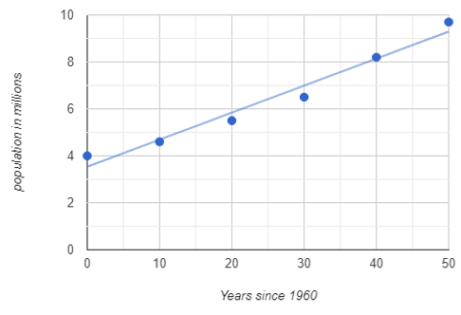
Applications: find the function?
Georgia - Historical Population Data
Years since 1960 | Population
50 | 9.7 m
40 | 8.2 m
30 | 6.5 m
20 | 5.5 m
10 | 4.6 m
0 | 4.0 m

