Slide 1
Exponential Functions
By Houbin Fang

Slide 2
Exponential Functions
Exponential function: $f\left(x\right)=b^{x}$
b is called the base,
b > 0, $b≠1$,
x is any real number.

Slide 3
Evaluating $f\left(x\right)=2^{x}$ for x = 3, -2

Slide 4
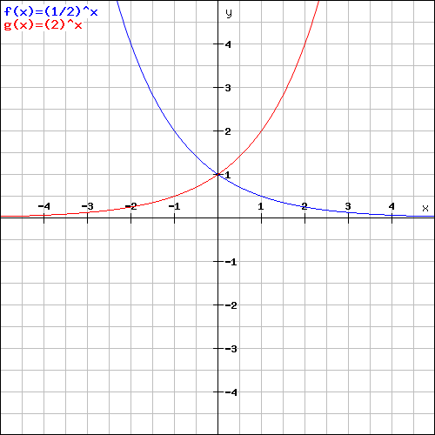
Graphs of Exponential Functions （0,1）
(0, 1)
B range, property
Growth and Decay

Slide 5
Exponential Functions
$f\left(x\right)={0.25}^{x}$ growth or decay?

Slide 6
Graph an Exponential Function
$g\left(x\right)={\left(\frac{3}{4}\right)}^{x}$growth or decay? Graph?

Slide 7
Graph an Exponential Function
$g\left(x\right)=3^{x}$growth or decay? Graph?

Slide 8
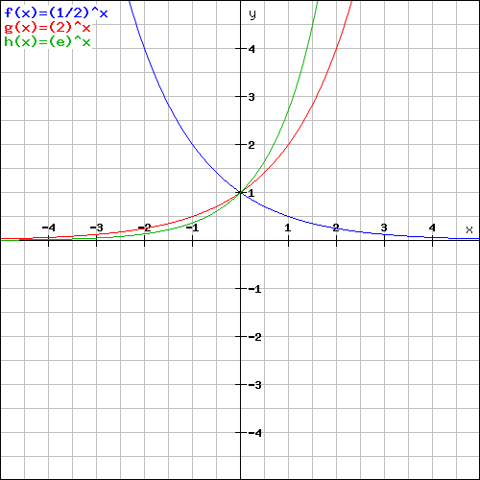
The Natural Exponential Function
$e≈2.71828$, $f\left(x\right)=e^{x}$ is called the natural exponential function.

Slide 9
Evaluate the Natural Exponential Function $f\left(x\right)=2^{x}$ for x = 2, 3, and -4.

Slide 10
Applications of Exponential Functions
compound interest formula:
$$A=P{\left(1+\frac{r}{n}\right)}^{nt}$$
Principal $1000
3% interest compounded daily
Find the value of the investment after 3 years.

