Slide 1
Quadratic Functions
By Houbin Fang

Slide 2
Quadratic Functions
A quadratic function form y = $ax^{2}+bx+c, a≠0$.
parabola.

Slide 3
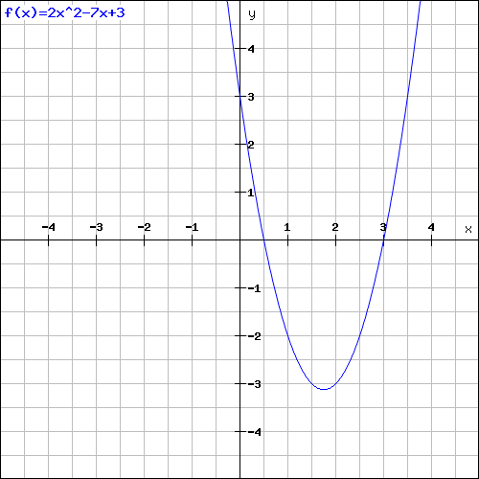
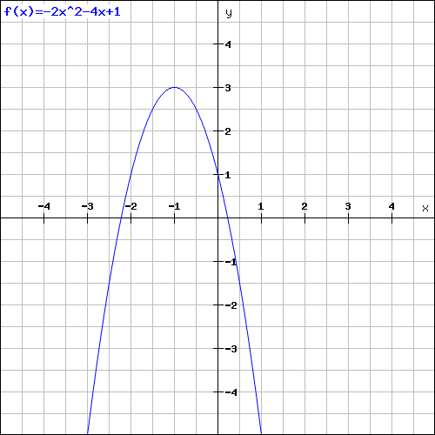
Quadratic Functions
Examples of quadratic functions are given below:
$f\left(x\right)={2x}^{2}−7x+3 a= , b= , c=$
$g\left(t\right)=−2t^{2}−4 t+1 a= , b= , c=$

Slide 4
Quadratic Functions
the smallest y-coordinate a > 0
the largest y-coordinate a < 0
minimum or maximum: vertex
$$f\left(x\right)=2x^{2}−4x−3$$
$$f\left(x\right)=−x^{2}+4x+3$$

Slide 5
Quadratic Functions
The axis of symmetry
the two portions of the graph will match up.

Slide 6

Vertex of a Parabola: $y=−x^{2}+3x+1$.
Vertex: $\left(−\frac{b}{2a}, f\left(−\frac{b}{2a}\right)\right)$

Slide 7
x-Intercepts
Quadratic Formula
$x=\frac{−b±\sqrt{b^{2}−4ac}}{2a}$

Slide 8
Find the x-Intercept(s) of a Parabola
$y=x^{2}+5x+4$

Slide 9
Find the x-Intercept(s) of a Parabola
Formular$: y=2x^{2}−5x+2$

Slide 10
Find the x-Intercept(s) of a Parabola
Formular: $y={2x}^{2}−5x−3$

Slide 11
Minimum or Maximum of a Parabola
a > 0: vertex = the minimum y-coordinate.
a < 0: vertex = the maximum y-coordinate.

Slide 12
Finding the Min or Max
Find the max or min of the function $f\left(x\right)=−x^{2}+2x+3$.
Use the formula for the coordinates of the vertex: $\left(−\frac{b}{2a},f\left(−\frac{b}{2a}\right)\right)$

Slide 13
Applications of Quadratic Functions
Throw a subject initial velocity of 48 ft/s.
height h: h (t) = – 16$t^{2}$ + 48t + 4.
Graph, vertex, max/min, vertical

